Slide 1
Introduction to Python Programming: Learn the different libraries – NumPy, Pandas, SciPy, Matplotlib, Scikit Learn.
Practical No. 2

Slide 2
What is Python
Python is a general programming language with the following features:
–An object-based high-level programming language
–A free software released under an open-source license
–Cross-platform: Windows, Linux/Unix, MaxOSX etc
–A very readable and concise language with clear non-verbose syntax
–A large variety of high-quality packages are available for various applications online and free to use

Slide 3
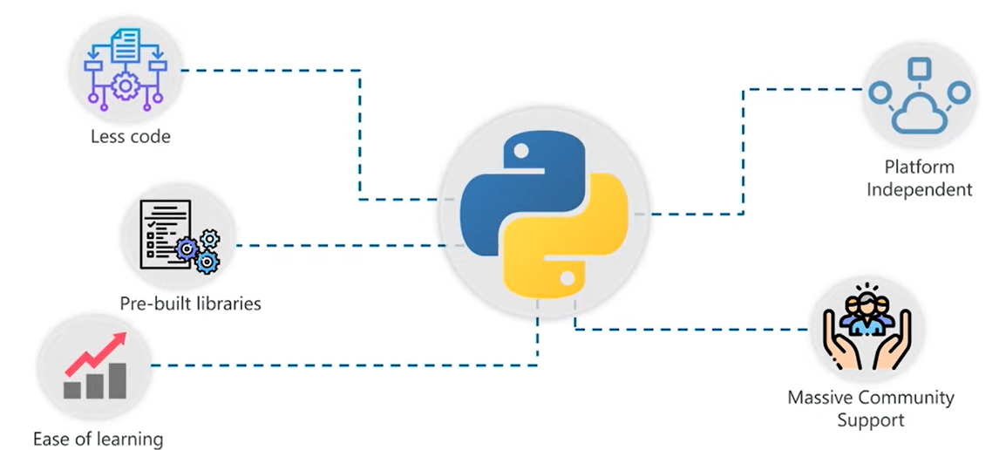
Why Python is used in Machine Learning

Slide 4
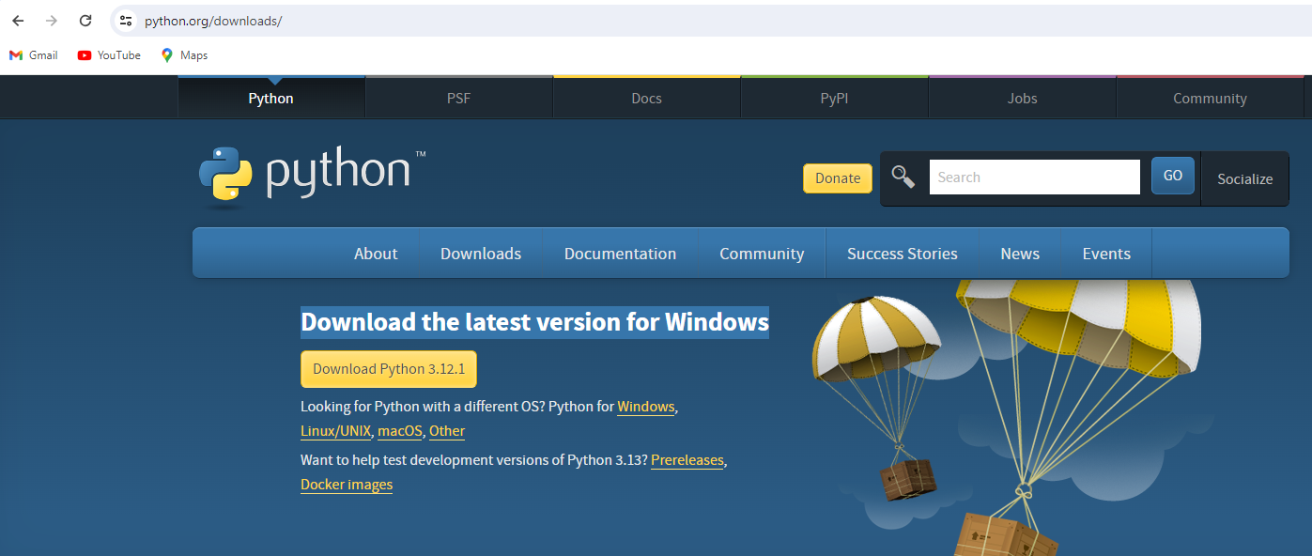
Python
To check if you have python installed, then open the command line and type:
python –version
If Not installed, then to install Python, Go to https://www.python.org/
Click on download tab
Download the latest version for Windows

Slide 5
Learn Python
To learn Python, Go to https://www.w3schools.com/python/default.asp

Slide 6
Commonly-used Python editors
Google Colaboratory, or Colab, is an as-a-service version of Jupyter Notebook that enables you to write and execute Python code through your browser.
JupyterNotebook - A web-based interactive computational environment, Can contain code, text, mathematics, plots and rich media, Can work interactively, Easy to visualize results, Easy to share with others
PyCharm - easy to work with when working on a large project containing different Python files, Can see intermediate results in debugging mode
Python Terminal - You can use the Python terminal for interactive computing in Python

Slide 7
Google Collab
Learn about Google collab using the url below
https://colab.research.google.com/#
Login using your gmail id

Slide 8
Overview of Data Structures in Python

Slide 9
Exercises 1 – data types in Python
x = 1 # int y = 2.8 # float z = 1j # complex #convert from int to float: a = float(x) #convert from float to int: b = int(y) #convert from int to complex: c = complex(x) print(a) print(b) print(c) print(type(a)) print(type(b)) print(type(c))
a = "Hello" print(a)
Get the character at position 1 (remember that the first character has the position 0):
a = "Hello, World!" print(a[1])
Loop through the letters in the word “AIMSR":
for x in “AIMSR": print(x)
The len() function returns the length of a string:
a = "Hello, World!"
print(len(a))
Check if "free" is present in the following text:
txt = "The best things in life are free!"
print("free" in txt)
x = 1.10 y = 1.0 z = -35.59 print(type(x)) print(type(y)) print(type(z))

Slide 10
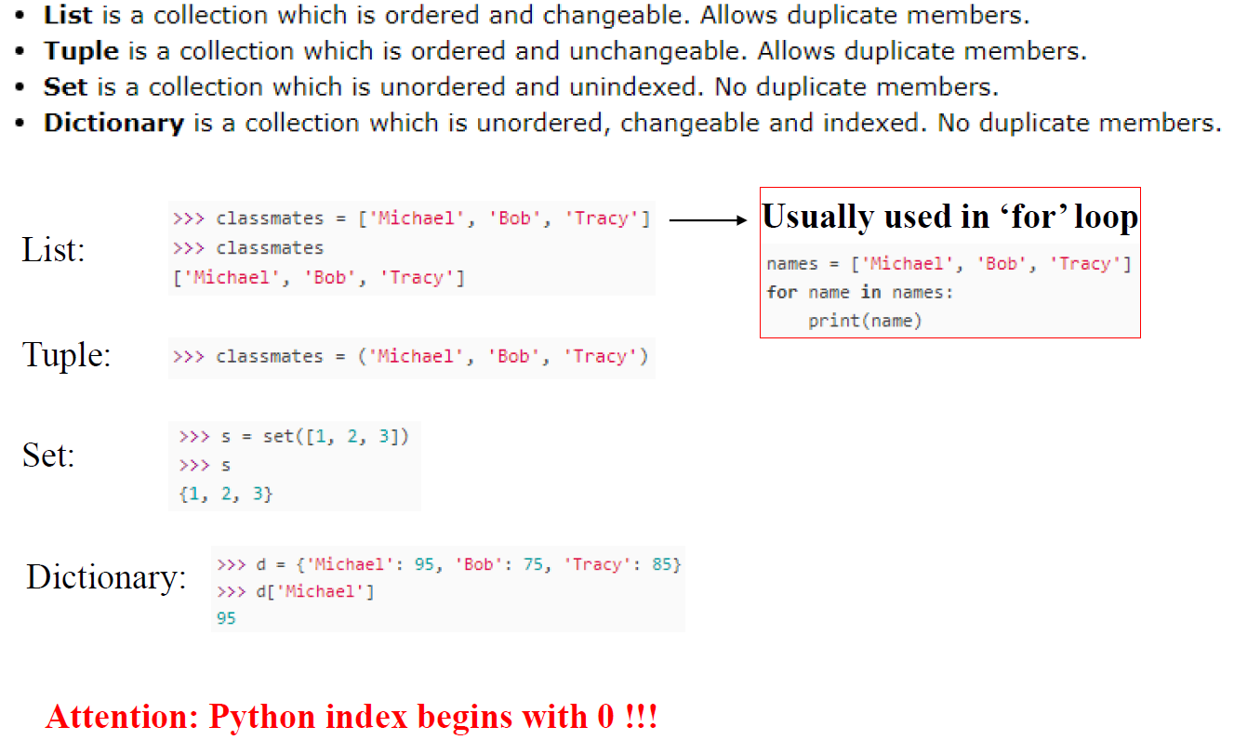
Lists, Tuple, Set, Dictionary

Slide 11
Exercises – Lists, Tuples
thislist = ["apple", "banana", "cherry"] print(thislist)
Print the number of items in the list:
print(len(thislist))
Using the append() method to append an item:
thislist.append("orange") print(thislist)
Insert an item as the second position:
thislist = ["apple", "banana", "cherry"]
thislist.insert(1, "orange")
print(thislist)
Remove "banana":
thislist.remove("banana")
print(thislist)
Remove the second item:
thislist = ["apple", "banana", "cherry"] thislist.pop(1) print(thislist)
Clear the list content:
thislist = ["apple", "banana", "cherry"] thislist.clear() print(thislist)
Print all items in the list, one by one:
thislist = ["apple", "banana", "cherry"] for x in thislist: print(x)
Print all items by referring to their index number:
thislist = ["apple", "banana", "cherry"] for i in range(len(thislist)): print(thislist[i])
Tuples are used to store multiple items in a single variable.
Tuple is one of 4 built-in data types in Python used to store collections of data, the other 3 are List, Set, and Dictionary, all with different qualities and usage.
A tuple is a collection which is ordered and unchangeable.
Tuples are written with round brackets.
thistuple = ("apple", "banana", "cherry") print(thistuple)
Print the number of items in the tuple:
print(len(thistuple))

Slide 12
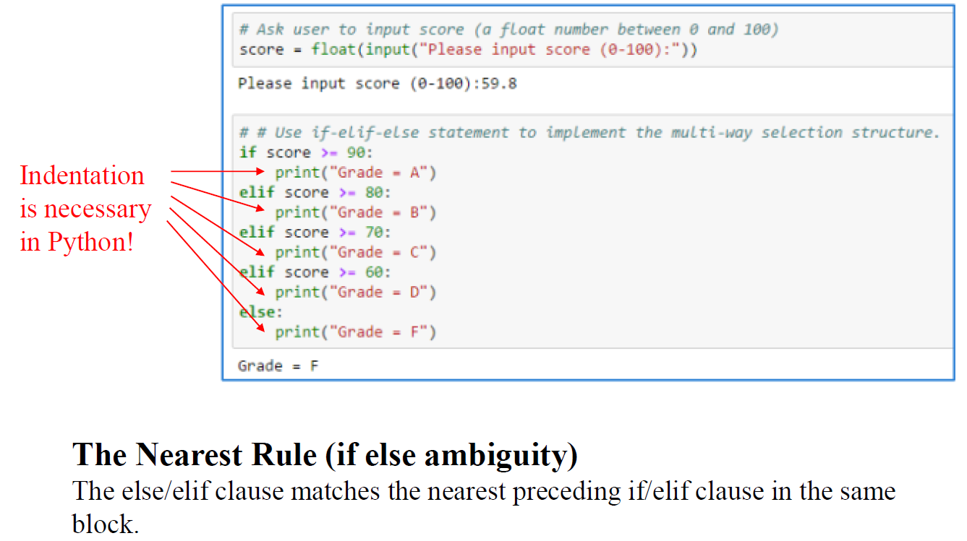
If-elif-else Selection Structure in Python

Slide 13
Exercises for IF Else
a = 200 b = 33 if b > a: print("b is greater than a") elif a == b: print("a and b are equal") else: print("a is greater than b")
One line if else statement, with 3 conditions:
a = 330 b = 330 print("A") if a > b else print("=") if a == b else print("B")
Test if a is NOT greater than b:
a = 33
b = 200
if not a > b:
print("a is NOT greater than b")
Nested If
x = 41
if x > 10:
print("Above ten,")
if x > 20:
print("and also above 20!")
else:
print("but not above 20.")

Slide 14
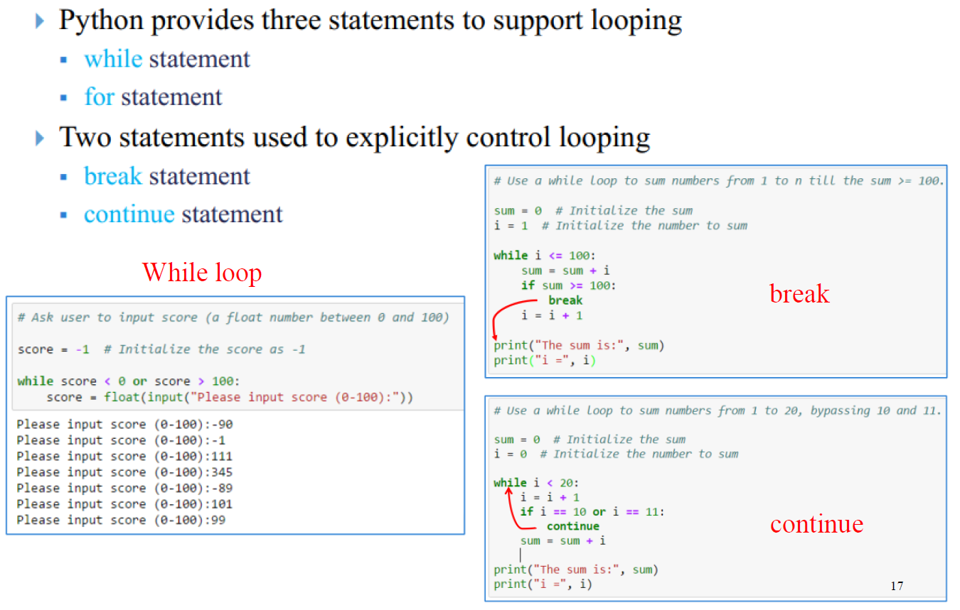
Iteration/Loop Structure

Slide 15
While/For Loop
fruits = ["apple", "banana", "cherry"] for x in fruits: print(x)
Exit the loop when x is "banana":
fruits = ["apple", "banana", "cherry"]
for x in fruits:
print(x)
if x == "banana":
break
With the continue statement we can stop the current iteration of the loop, and continue with the next:
Do not print banana:
fruits = ["apple", "banana", "cherry"] for x in fruits: if x == "banana": continue print(x)
To loop through a set of code a specified number of times, we can use the range() function,
The range() function returns a sequence of numbers, starting from 0 by default, and increments by 1 (by default), and ends at a specified number.
for x in range(6):
print(x)
Using the start parameter:
for x in range(2, 6):
print(x)
Increment the sequence with 3 (default is 1):
for x in range(2, 30, 3): print(x)
i = 1 while i < 6: print(i) i += 1
With the break statement we can stop the loop even if the while condition is true:
Exit the loop when i is 3:
i = 1 while i < 6: print(i) if i == 3: break i += 1
With the continue statement we can stop the current iteration, and continue with the next:
Continue to the next iteration if i is 3:
i = 0 while i < 6: i += 1 if i == 3: continue print(i)
Print a message once the condition is false:
i = 1 while i < 6: print(i) i += 1 else: print("i is no longer less than 6")

Slide 16
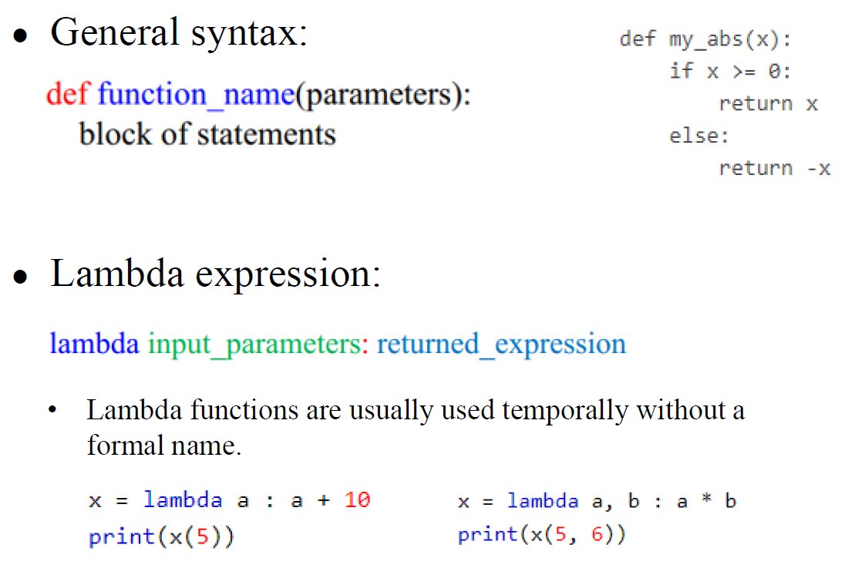
Function Definition in Python

Slide 17
Python Functions
In Python a function is defined using the def keyword:
To call a function, use the function name followed by parenthesis:
def my_function(): print("Hello from a function") my_function()
Information can be passed into functions as arguments.
def my_function(fname): print(fname + " Singh") my_function(“Pankaj") my_function(“Vijay") my_function(“Abhishek")
This function expects 2 arguments, and gets 2 arguments:
def my_function(fname, lname): print(fname + " " + lname) my_function(“Vijay", “Singh")
Passing a List as an Argument
def my_function(food): for x in food: print(x) fruits = ["apple", "banana", "cherry"] my_function(fruits)
To let a function return a value, use the return statement:
def my_function(x): return 5 * x print(my_function(3)) print(my_function(5)) print(my_function(9))
A lambda function is a small anonymous function.
A lambda function can take any number of arguments, but can only have one expression.
Add 10 to argument a, and return the result:
x = lambda a : a + 10
print(x(5))
Multiply argument a with argument b and return the result:
x = lambda a, b : a * b
print(x(5, 6))
Summarize argument a, b, and c and return the result:
x = lambda a, b, c : a + b + c
print(x(5, 6, 2))

Slide 18
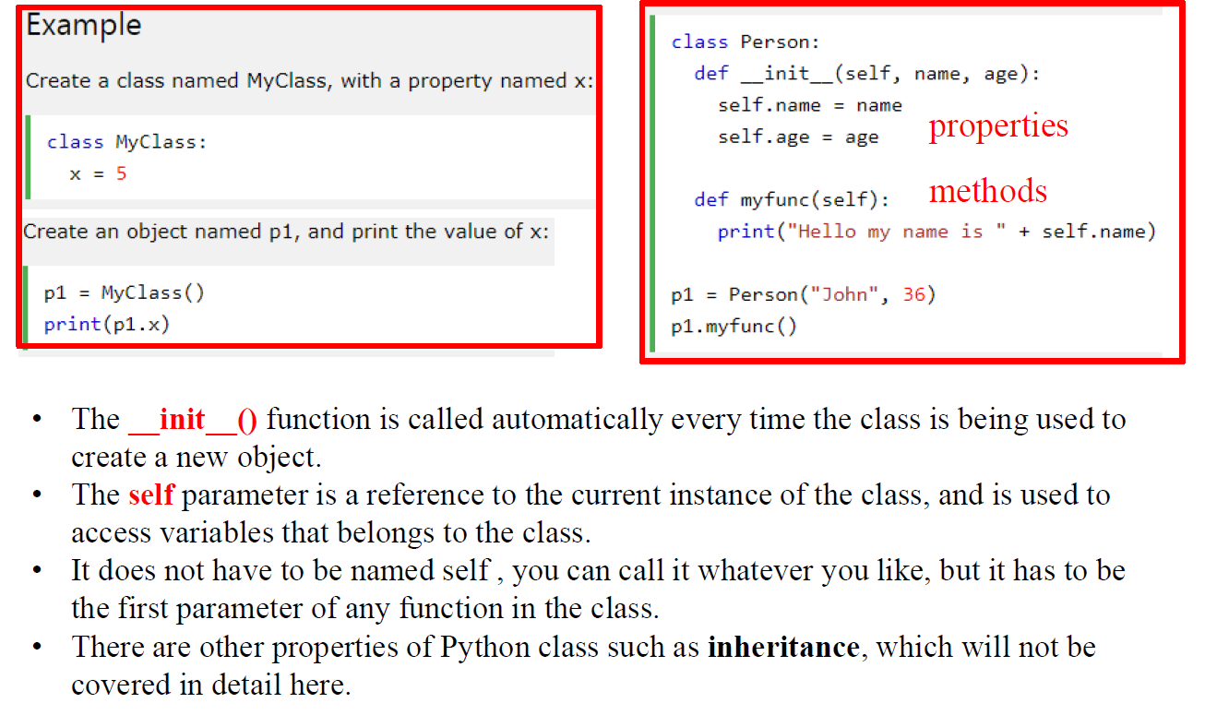
Python Class Definition

Slide 19
Python Classes and Objects
Create a class named MyClass, with a property named x:
class MyClass: x = 5
Create an object named p1, and print the value of x:
p1 = MyClass() print(p1.x)
Create a class named Person, use the __init__() function to assign values for name and age:
class Person: def __init__(self, name, age): self.name = name self.age = age p1 = Person("John", 36) print(p1.name) print(p1.age)
The string representation of an object WITHOUT the __str__() function:
class Person: def __init__(self, name, age): self.name = name self.age = age p1 = Person("John", 36) print(p1)
The string representation of an object WITH the __str__() function:
class Person: def __init__(self, name, age): self.name = name self.age = age def __str__(self): return f"{self.name}({self.age})" p1 = Person("John", 36) print(p1)
Objects can also contain methods. Methods in objects are functions that belong to the object.
Let us create a method in the Person class:
Insert a function that prints a greeting, and execute it on the p1 object:
class Person: def __init__(self, name, age): self.name = name self.age = age def myfunc(self): print("Hello my name is " + self.name) p1 = Person("John", 36) p1.myfunc()
Use the words mysillyobject and abc instead of self:
class Person: def __init__(mysillyobject, name, age): mysillyobject.name = name mysillyobject.age = age def myfunc(abc): print("Hello my name is " + abc.name) p1 = Person("John", 36) p1.myfunc()
You can modify properties on objects like this:
Set the age of p1 to 40:
p1.age = 40
Delete the age property from the p1 object:
del p1.age
Delete the p1 object:
del p1

Slide 20
Python Libraries for Data Science
Many popular Python toolboxes/libraries:
NumPy
SciPy
Pandas
SciKit-Learn
Visualization libraries
matplotlib
and many more …

Slide 21

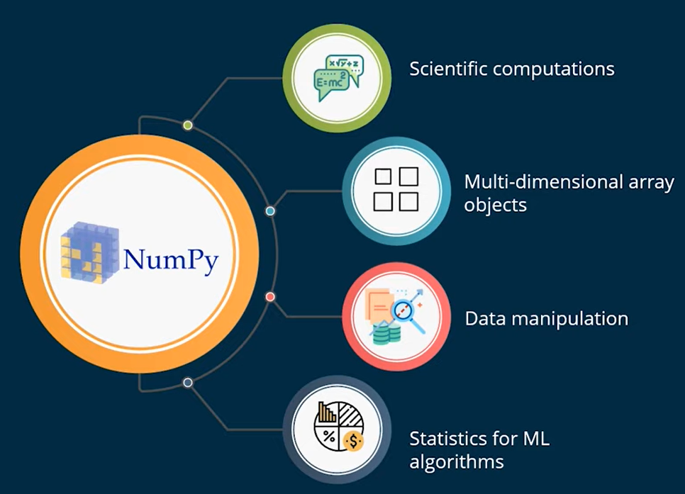
Python Libraries for Data Science
NumPy:
Introduces objects for multidimensional arrays and matrices
Functions that allow to easily perform advanced mathematical and statistical operations on those objects
Provides vectorization of mathematical operations on arrays and matrices which significantly improves the performance
many other python libraries are built on NumPy
To know more go to Link: http://www.numpy.org/
To learn the syntax etc. go to https://www.w3schools.com/python/numpy/numpy_getting_started.asp

Slide 22
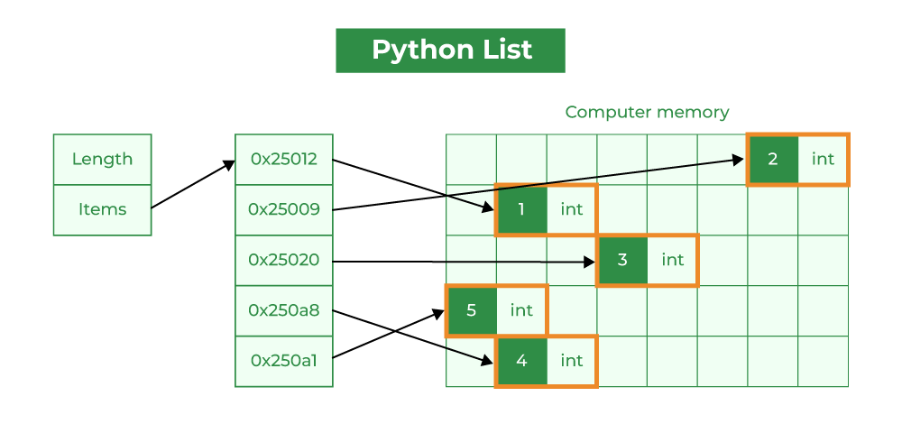
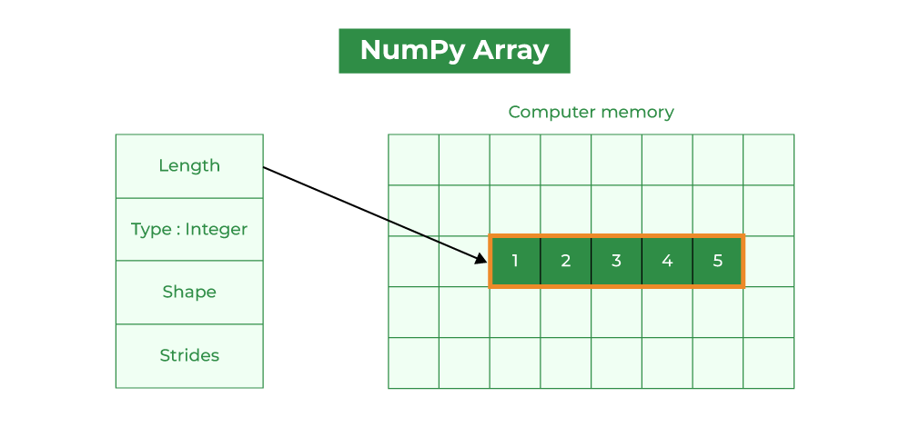
Difference between Lists and Numpy
Lists - Slow | Numpy - Fast
Element Overhead: Lists in Python store additional information about each element, such as its type and reference count. This overhead can be significant when dealing with a large number of elements. Datatype: Lists can hold different data types, but this can decrease memory efficiency and slow numerical operations. Memory Fragmentation: Lists may not store elements in contiguous memory locations, causing memory fragmentation and inefficiency. Performance: Lists are not optimized for numerical computations and may have slower mathematical operations due to Python’s interpretation overhead. They are generally used as general-purpose data structures. Functionality: Lists can store any data type, but lack specialized NumPy functions for numerical operations. | Homogeneous Data: NumPy arrays store elements of the same data type, making them more compact and memory-efficient than lists. Fixed Data Type: NumPy arrays have a fixed data type, reducing memory overhead by eliminating the need to store type information for each element. Contiguous Memory: NumPy arrays store elements in adjacent memory locations, reducing fragmentation and allowing for efficient access. Array Metadata: NumPy arrays have extra metadata like shape, strides, and data type. However, this overhead is usually smaller than the per-element overhead in lists. Performance: NumPy arrays are optimized for numerical computations, with efficient element-wise operations and mathematical functions. These operations are implemented in C, resulting in faster performance than equivalent operations on lists.

Slide 23
Numpy examples
1. The following example shows how to initialize a array from a list.
import numpy as np
li = [1, 2, 3, 4]
numpyArr = np.array(li)
print(numpyArr)
2. Check whether the numpyArr is a NumPy object or not. In this example, we are using the array() function to convert the list into a NumPy array and then check if it’s a NumPy object or not.
import numpy as np
li = [1, 2, 3, 4]
numpyArr = np.array(li)
print("li =", li, "and type(li) =", type(li))
print("numpyArr =", numpyArr, "and type(numpyArr) =", type(numpyArr))
3. A one-dimensional array is a type of linear array.import numpy as np
# importing numpy module
import numpy as np
# creating list
list = [1, 2, 3, 4]
# creating numpy array
sample_array = np.array(list1)
print("List in python : ", list)
print("Numpy Array in python :", sample_array)))

Slide 24
Numpy Exercises
Generate a 1-D array of 10 random integers. Each integer should be a number between 10 and 40 (inclusive)
Add 202 to all the values in the above array
Replace all odd numbers in the given array with -1
Convert a 1-D array of any 9 numbers into a 2-D array with 3 rows
For array of x = [21, 64, 86, 22, 74, 55, 81, 79, 90, 89] and y = np.array([21, 7, 3, 45, 10, 29, 55, 4, 37, 18])
Find the positions of:
elements in x where its value is more than its corresponding element in y, and
elements in x where its value is equals to its corresponding element in y.

